Slide 1
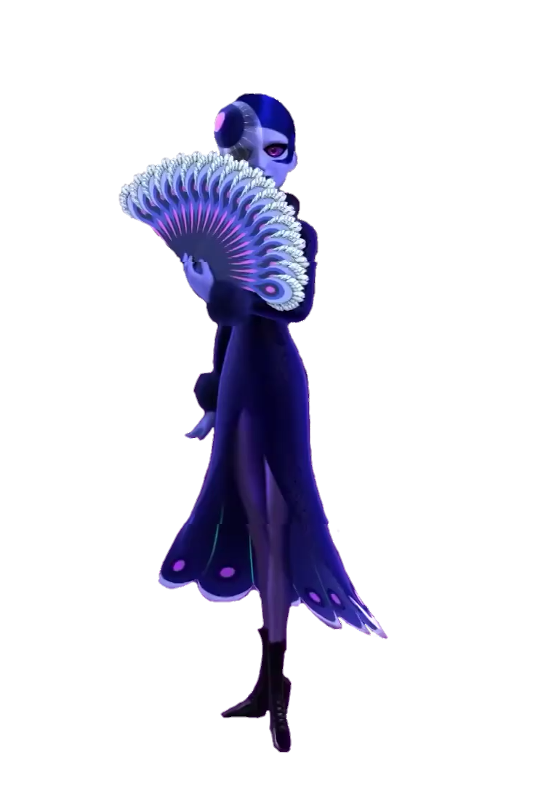
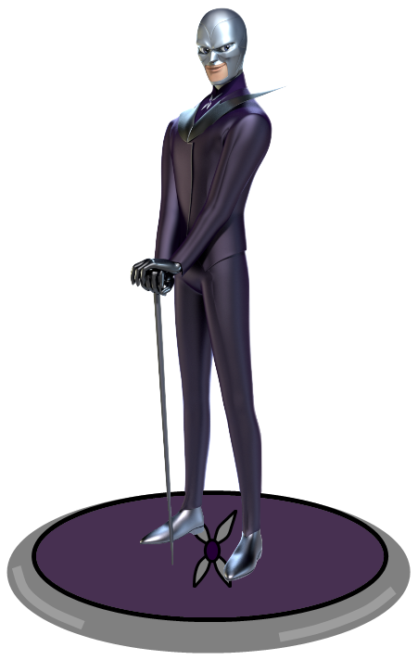
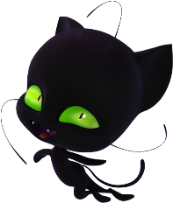
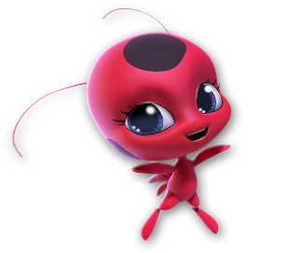
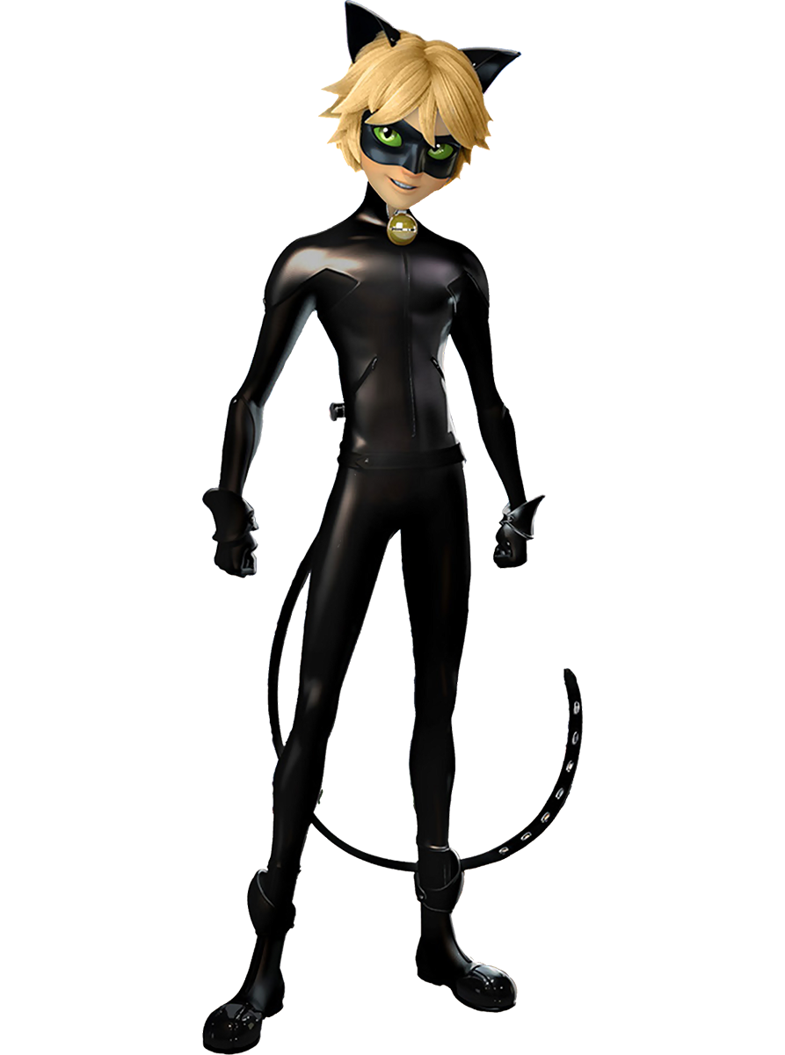
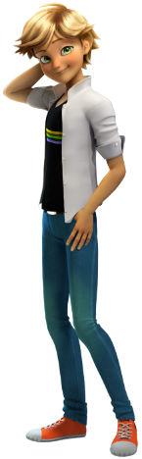
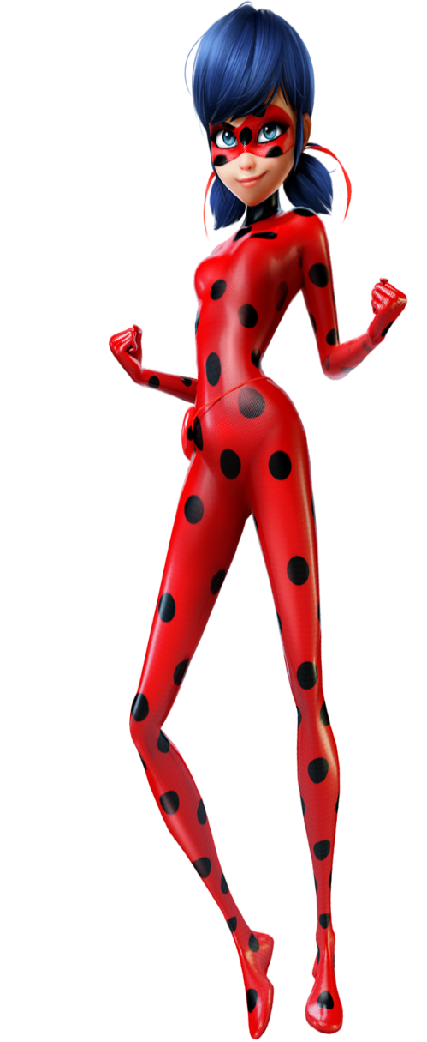
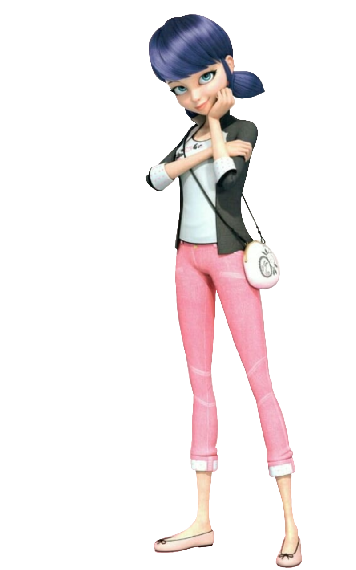

T
The Battle Of Miraculous
Start

Slide 2
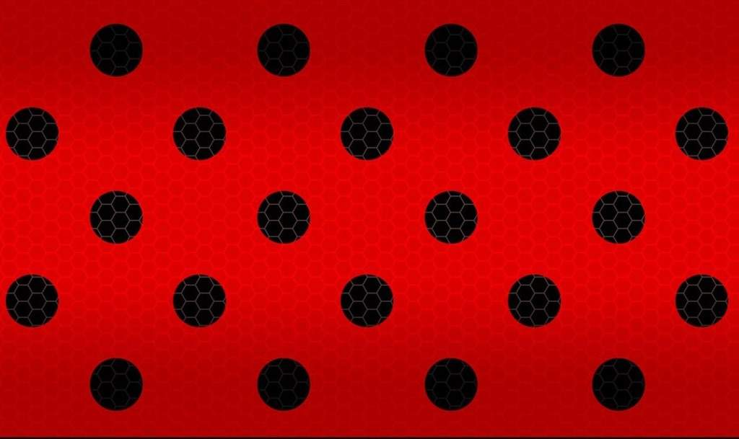
Next →
Welcome to the Miraculous World where anything can happen.
The characters are – Adrien Agreste as superhero Cat Noir
Plagg a magical kwami
Marinette Dupain-Cheng as superhero Ladybug
Tikki a magical kwami
Hawk Moth (villain)
Mayura (villain’s sidekick)
Level 1 – Don’t get touched by any obstacle all you’ll have to start from the initial place.
Level 2 – Don’t get touched by the akumas and amok or else you’ll lose 1 life, you have total 3 lives.
Collect cheese and cookie for health.
Level 3 – Defeat the villains by using your super-powers “cataclysm” for destroying an akuma & “lucky-
charm” for destroying an amok. Don’t get touched by the villains powers.
*Use arrow keys to move for level 1 & 2. Use “C” for “cataclysm” and “L” for “lucky-charm”.
Adrien & Marinette are our superheroes and their powers are granted by miraculouses which is a jewel and a kwami. Adrien has Plagg as his kwami and grant him the power of destruction and Marinette has Tikki has her kwami and grant her the power of creation. If these two miraculouses are used together than it will make the user the most powerful and grant a wish to the user. Hawk Moth is the villain and wants these 2 miraculouses for evil.

Slide 3


Next →
Marinette : Oh Adrien, I have a very bad news. I have no idea how Tikki is kidnapped by Hawk Moth and Mayura. She somehow managed to tell me where she is and what had happened to her. But the problem is a normal human can’t go the place she was. I don’t know what to do, without her I can not be Ladybug also. Only you can help me.
Level – 1
The rescue
(Tikki and Plagg)
Adrien : Oh no, it’s really a very bad news . But don’t worry I have a plan , Plagg can go there and save her with his super powers as we can’t go there. Next, after saving Tikki, they will tell us the way to reach Hawk Moth and Mayura and we will then go there and fight the villains and defeat them. I’m sure we’ll win.

Slide 4
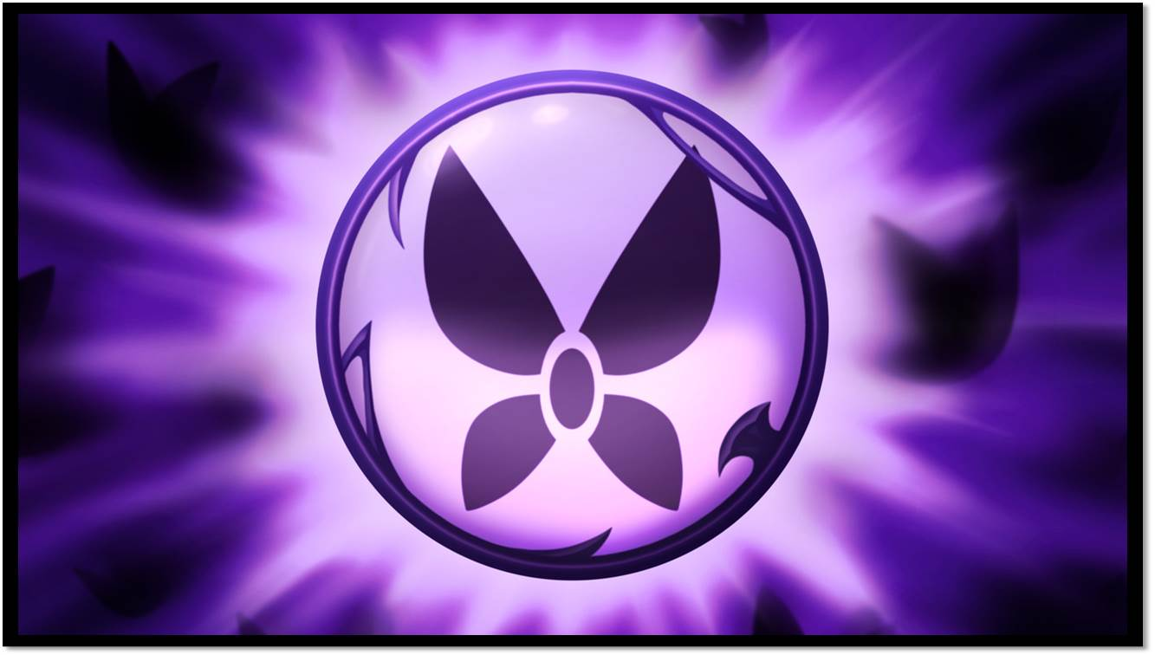




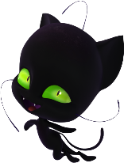

DEATHS : 00

Slide 5
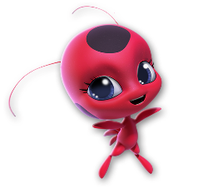
Next →
Marinette : Oh Tikki, I’m glad to see you again. I missed you. Thanks a lot Plagg. Yeah right Adrien , we must go on the mission.
Tikki : I missed you too Marinette.
Level – 2
On the way
(Adrien and Plagg , Marinette and Tikki)
Plagg : Thanks Marinette. Thanks Adrien.
Adrien : Great Job Plagg. So, now we know where is Hawk Moth and Mayura. We must start the mission and reach the place.

Slide 6
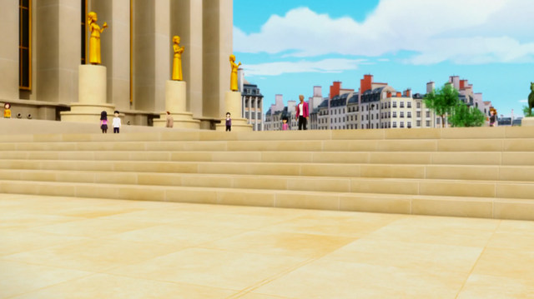
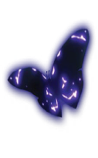



Deaths : 00 Power up : 02

Slide 7
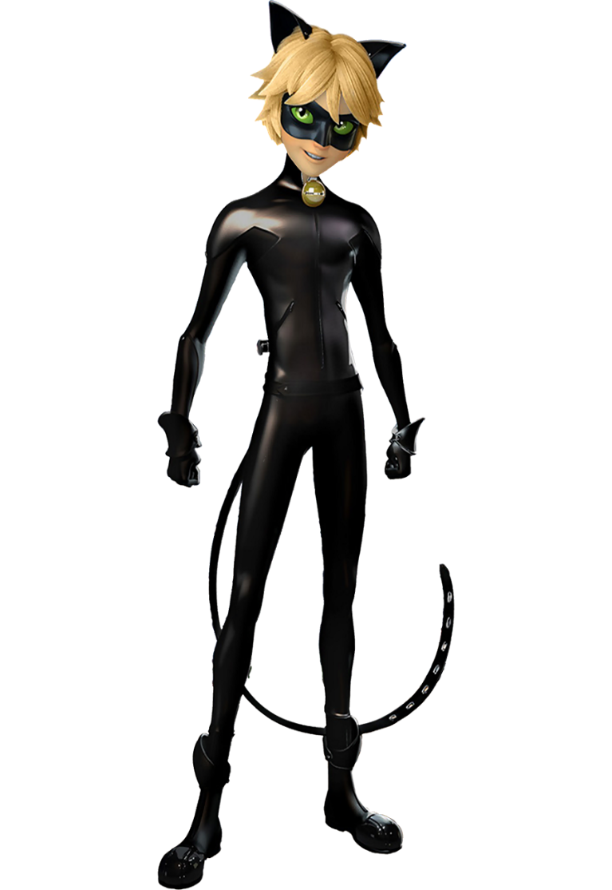

Next →
Marinette : Tikki, Spots On.
Ladybug : At last we are here, Good Luck Cat Noir.
Level – 3
The battle of miraculous
(Cat Noir and Ladybug vs Hawk Moth and Mayura)
Adrien : Plagg, Claws Out.
Cat Noir : Good Luck, Ladybug.

Slide 8
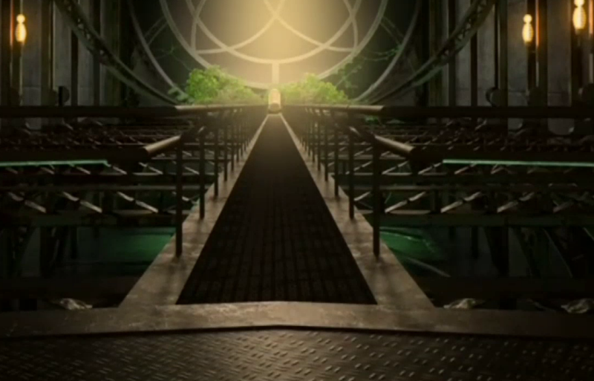
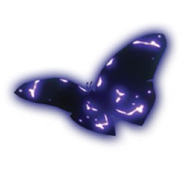



Cat Noir :Cataclysm
Ladybug :Lucky charm
Deaths : 00 Power of Villains : 50

Slide 9
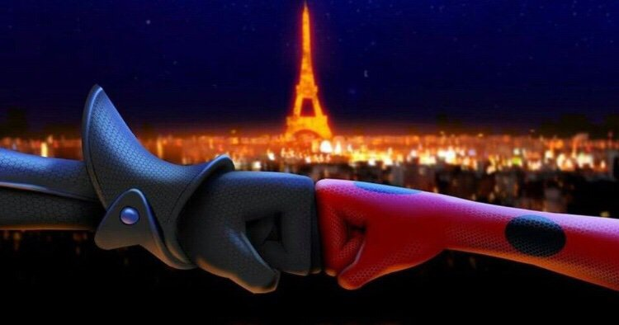
Explore some more Miraculously
Paw-some games
🐞You Win🐾
!!Pound It !!

Slide 10
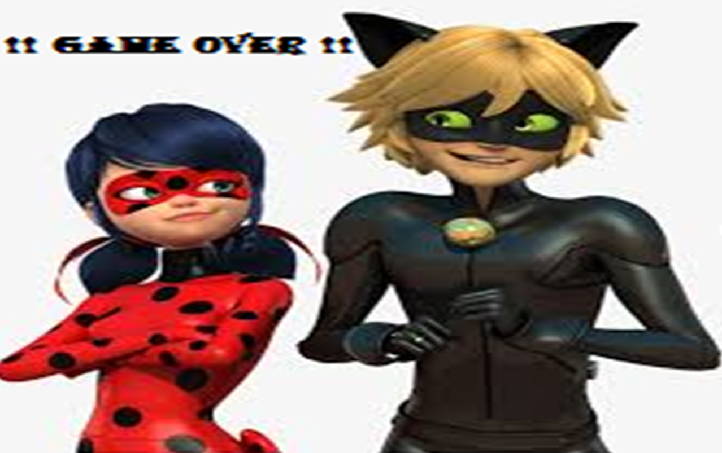
Press space for restarting the game

Slide 11
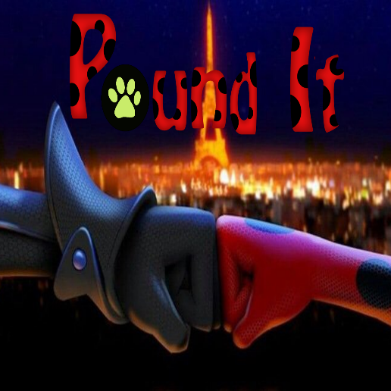
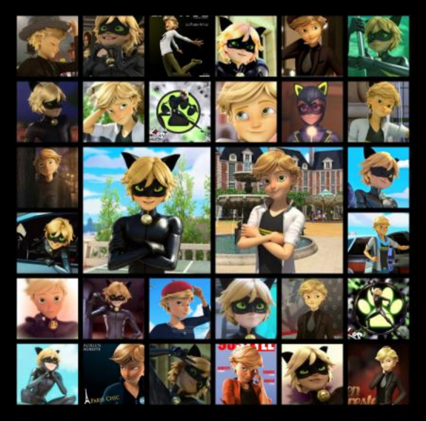
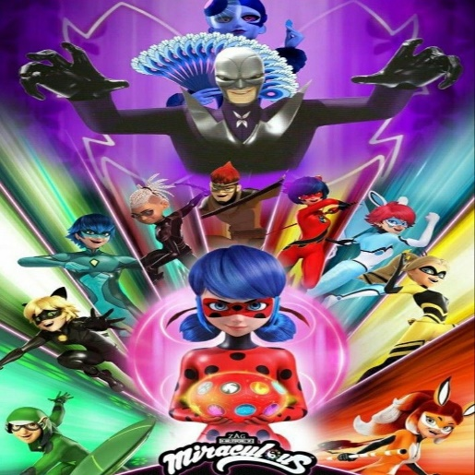


Enjoy with
our Heroez🐞🐾
Miraculous Moth Breaker
The Miraculous Rush
It’s Miraculous : Quiz
- Anushreya Satish

